Slide 1


BUILDING A BUSINESS CASE FOR RESOURCE PLANNING SOFTWARE
TRANSF0RMING EFFICIENCY THROUGH STRATEGIC INVESTMENT
[PRESENTER NAME]| [DATE]

Slide 2
AGENDA
01
EXECUTIVE SUMMARY
02
CURRENT SITUATION ANALYSIS
03
SOLUTION OVERVIEW
04
FINANCIAL ANALYSIS
05
RISK ASSESSMENT
06
IMPLEMENTATION TIMELINE
07
NEXT STEPS

Slide 3
EXECUTIVE SUMMARY
The challenge: Our organisation is grappling with inefficient resource allocation, leading to lost revenue, reduced employee morale, and missed opportunities.
The analysis: We've conducted a thorough evaluation of our current workflows, identifying key areas where improvements are crucial for both operational excellence and employee well-being.
The solution: Implementing a comprehensive Resource Planning Software is not just a quick fix; it's a strategic move. This software will streamline our processes, improve project management, and ultimately boost our bottom line.
The opportunity: Early projections indicate that we can expect a Return on Investment (ROI) of X% within Y months, alongside qualitative benefits like improved team collaboration and job satisfaction.

Slide 4
CURRENT SITUATION ANALYSIS
Key findings:
  Operational inefficiencies: Current systems and processes are causing delays, leading to X% in wasted time.
  Resource allocation: Our current approach has led to imbalanced workloads, affecting employee satisfaction and increasing turnover rates.
  Financial impact: These inefficiencies have resulted in a financial loss of £X million over the last financial year.
  Employee morale: Inefficient resource planning contributes to workplace stress and reduced job satisfaction, affecting our overall company culture.
  Productivity: Suboptimal resource allocation has led to a X% decrease in productivity, negatively impacting project deadlines and client satisfaction.
The data speaks
📈 Metrics:
  X% increase in project delays
  Y% decrease in customer satisfaction ratings
  Z% rise in operational costs
📋 Real-life examples:
  Case Study 1: The recent [Project name] was delayed by X weeks, costing us £Y.
  Case Study 2: Employee surveys indicate dissatisfaction levels are at an all-time high, affecting team morale.

Slide 5
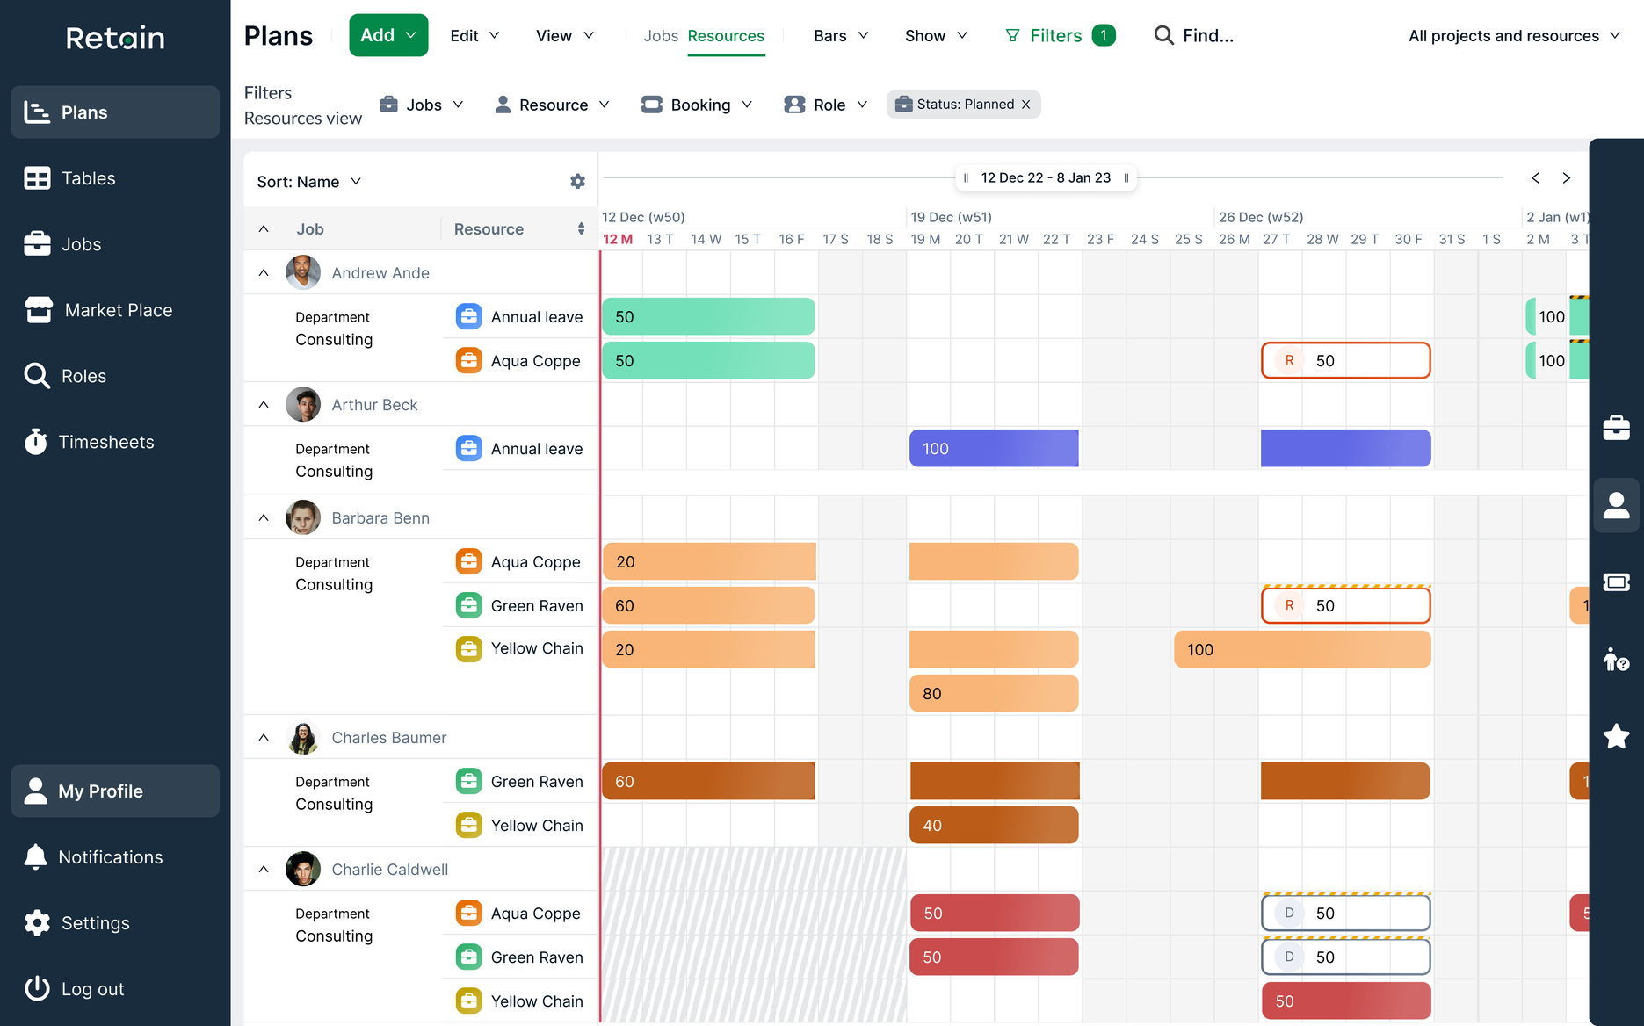

SOLUTION
OVERVIEW
ATTRACT. RETAIN. DEVELOP
Seek out the best new talent in an unbiased, inclusive and transparent way while keeping hold of existing staff and boosting training ROI through enhanced engagement and individualised career development support.
OUTSTANDING CLIENT EXPERIENCES
Retain Cloud enables you to manage your resources across multiple teams, with multiple skills across different locations and time zones for faster demand fulfilment, improved demand planning and exceptional client experiences.
PROFITABLE BUSINESS GROWTH
Work faster with access to a single, real-time view of all your resources, connecting key sources of information across your business, improving the tracking of billable utilisation and enhancing planning with scenario modelling.

Slide 6
FINANCIAL ANALYSIS
Current costs:
  Operational inefficiencies cost us approximately £X annually.
  Turnover and training new staff: £Y.
📉 Lost revenue:
  Project delays and inefficiencies have led to approximately £Z in lost revenue.
Software investment: Monthly pricing starts at £17 per user per month
📈 Projected ROI: Using Retain's free ROI calculator, our initial investment will yield an X% ROI within Y months.
Breakdown of savings
  An estimated reduction in resource utilisation saves us £X per year.
  Improved sourcing costs saves us £X per year.
  Revenue improvements increase by £X per year.
🔗 Try It Yourself:
Don't just take our word for it! Use Retain's free ROI calculator to run your own scenarios.

Slide 7
RISK ASSESSMENT
Key risks identified
  Implementation delays: New software implementations might face time overruns, affecting project timelines.
  Workflow disruption: An adjustment period is often required when shifting to a new system, potentially causing temporary inefficiencies.
  Data security: As with any new software, there's a potential risk of data breaches or loss.
Risk Mitigation Strategies
  Early pilot testing
  Resource buffer allocation
  Ongoing vendor support
  Gradual roll-out
  Comprehensive training sessions
  Immediate IT support availability
  Vendor's security certifications and compliance
  Regular backups and audits
  Multi-factor authentication
🔍 Ongoing Assessment:
  Plus, regular check-ins will be held to gauge progress and identify emerging risks, ensuring agile response strategies.

Slide 8


IMPLEMENTATION TIMELINE
01
02
03
04
MILESTONE 1
MILESTONE 2
MILESTONE 3
MILESTONE 4
Software selection and initial budget approval by [Date].
Complete initial training for all team leads by [Date].
Reach full operational capability by [Date].
Conduct a post-implementation review by [Date].

Slide 9
NEXT STEPS
Immediate next steps
✅ Secure budget approval: The first step is to get the budget approved for this project, targeted by [Date].
✅ Vendor Selection: Choose a vendor based on the selection criteria by [Date].
✅ Internal Champions: Identify team members who will serve as internal champions to facilitate smooth implementation.
Longer-term planning
📆 Pilot Testing: Commence by [Date] to gather initial feedback and make necessary adjustments.
📆 Regular Check-ins: Establish a series of regular progress reviews, starting from [Date].
📆 Post-Implementation Review: Scheduled for [Date] to evaluate the project's success and areas for improvement.
Questions & open discussion
❓ Your thoughts?: We're eager to hear your insights, concerns, or questions to help us refine this business case and make the project a success.

Slide 10
THANK YOU
For any further questions or discussions, please don't hesitate to reach out to [Your Name, Your Contact Information].

